Slide 1
DIGITAL CIRCUIT
AND
SYSTEMS MINI PROJECT

Slide 2
INTRODUCTION As time changes people are becoming more and more busy. They even forgot to Pump water for their Household purposes and agriculture. That’s , why we introduce NE555 IC based Automated Water level Controller.

Slide 3
WATER LEVEL CONTROLER

Slide 4
OVERVIEW
NE555 IC , Water Level Controller is a device that manages water level on a variety of systems such as water tanks , swimming pools, etc…
The basic functioning of this device is to Regulate
Water flow and optimize system performance

Slide 5
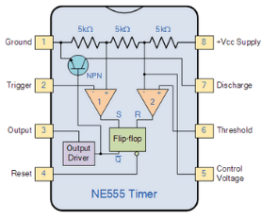
Components Required
NE555 timer IC -1
This 8-pin IC consists of one flip-flop, one inverter and three resistors.
The various pins are:
Ground- Ground reference voltage.
Trigger- High o/p when trigger pin falls below ⅓ of Vcc.
Output- High output when set pin is high, and low when reset pin is high.
Reset- Active low. When pin is high, it resets flip-flop.
Control- Has a default voltage of ⅔ Vcc.
Threshold- When its voltage is higher than that of pin 5, the flip-flop resets.
Discharge- It internally consists of an open collector output, which is useful in discharging a capacitor between intervals.
Vcc- The supply voltage is connected to the Vcc pin.
Notes:
the various pins are
ground reference voltage
the output will be high as long as the trigger pin falls below 1 by 3 of VCC voltage
this pin is high

Slide 6
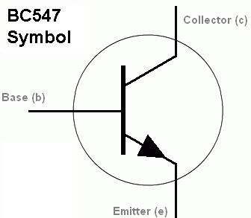
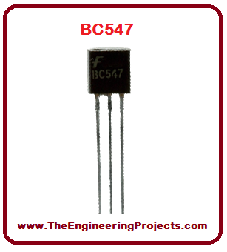
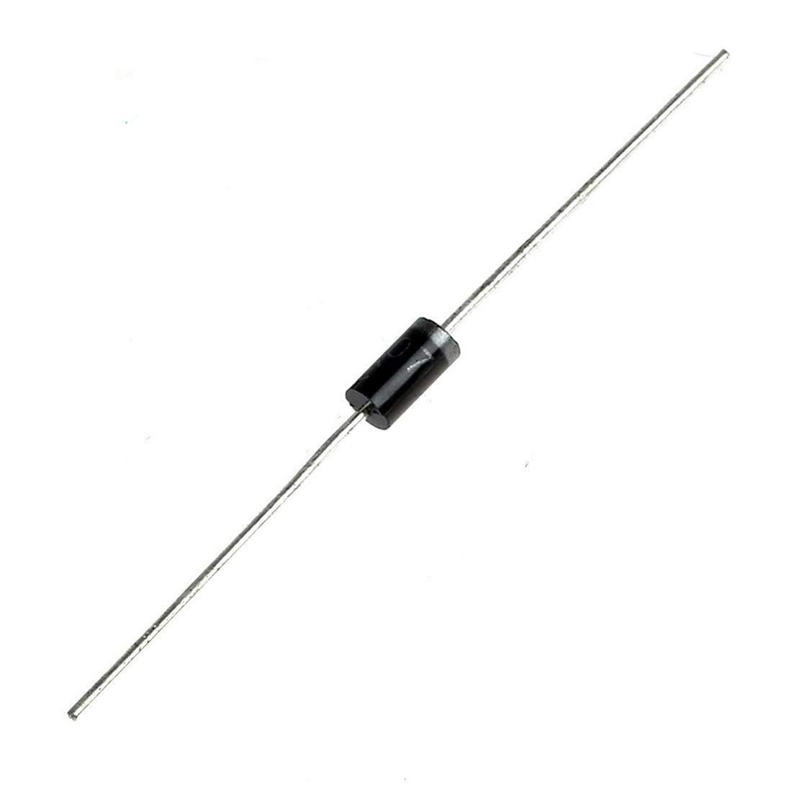
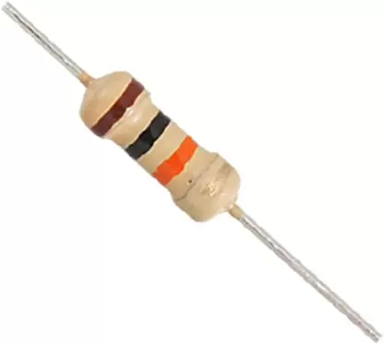
BC547 Transistor -1
It is an NPN transistor hence the collector and emitter will be
left open (reverse-biased) when the base pin is held at ground,
and will be closed when a signal is provided to the base pin.
IN4007 Diode -1
A diode is a semiconductor device which can
allow current in one and only one direction.
It is also called a Rectifier. The IN4007 is a plastic moulded
rectifier diode with high current capability and low voltage drop.
10kΩ Resistors -3, 1MΩ Resistors -2, 2.2kΩ Resistors -2
Resistors ensure components receive enough voltage by creating a voltage drop.
They also protect them from voltage spikes.
Notes:
A diode is a semiconductor device it can allow current in One Direction it does not allow current in other direction and diode is also called a rectifierIt is an NPN transistor hence the collector and emitter will be left open ine bracket reverse-biased when the base pin is held at ground and will be closed when a signal is provided to the base peak

Slide 7
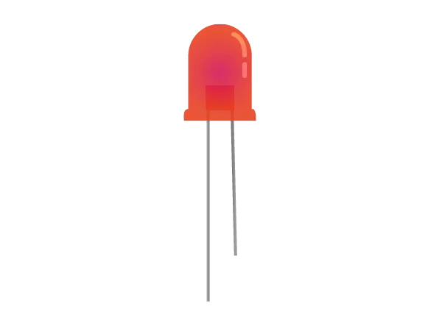
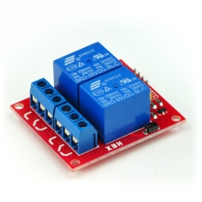
LED -2
A Light Emitting Diode is a semiconductor device that emits light when a forward voltage is applied to it.
12V Relay -1
It helps by shortening the heavy gauge power delivery wire from battery or the alternator to the load.
Wires

Slide 8
WORKING
In the Device setup, 3 wires namely VCC, LOW, HIGH act as sensors and are submerged underwater
Whenever the water is below HIGH level
Motor starts pumping water
Whenever the water just touches or reaches above HIGH level
Motor stops pumping water

Slide 9
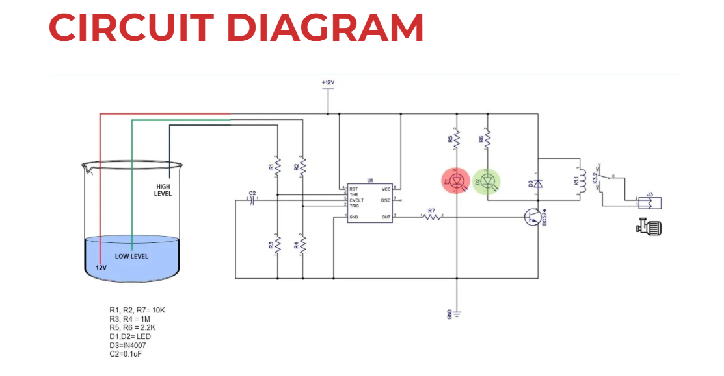
Circuit Diagram

Slide 10
TINKERCAD SIMULATION

Slide 11
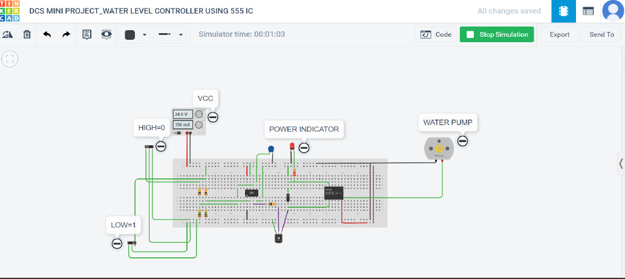

Slide 13
Applications
> Can be used in water tanks to control water levels
>Automatically turn ON/OFF pumps
>Can be used in factories, commercial complexes and home
>Fuel tank level gauging
>Oil tank level control
>High and low level alarms
>Pool water level control
>Life station switches
>Sewage pump level control
>Remote monitoring liquid
>Irrigation control

Slide 14
Advantages
>Power saver
>Money saver
>Automatic
>Water maximization
>Reliable electronic design
>Minimal maintenance

Slide 15
FUTURE ENHANCEMENT
The Device can be powered completely by solar energy
A small filter can be added to the pipe, through which water enters into the tank
Arduino can be used to modify the current technology
Various types of sensors can be used
Using a Voltage regulator we can adjust the speed and rate of flow of water

Slide 16
REFERENCE
https://www.youtube.com/watch?v=i0SNb__dkYI
https://www.technodudes.in/water-level-controller/
https://www.tutorialspoint.com/linear_integrated_circuits_applications/linear_integrated_circuits_applications_555_timer.html

Slide 17


